Slide 1


Data Governance @ SneakerPark
Prepared by: Cao Hoai Phuong
Submitted on:

Slide 2
Background
SneakerPark is an online shoe reseller that allows people to buy and sell used and new shoes. Buyers can bid for shoes or buy them outright, and sellers can set a price or sell to the highest bidder.
Each buyer and seller must have an active account in order to sell, bid, or purchase sneakers using SneakerPark’s website.
SneakerPark authenticates the shoes before shipping them to the buyer, so before listing an item, the seller must ship it to SneakerPark’s warehouse. Upon receipt, SneakerPark assigns an item number to each pair of sneakers and notifies the seller that they are now free to list their item. If the item is not listed within 45 days, SneakerPark returns it to the seller and sends an invoice to the seller for the shipping cost.
If the item is found to be inauthentic or in an unacceptable condition, it is also returned back to the seller in a similar fashion.
When the item sells, the buyer’s account is credited with the purchase price minus the SneakerPark service fee and shipping fees to deliver the item to the buyer.
Currently, SneakerPark only supports sales within the United States.

Slide 3
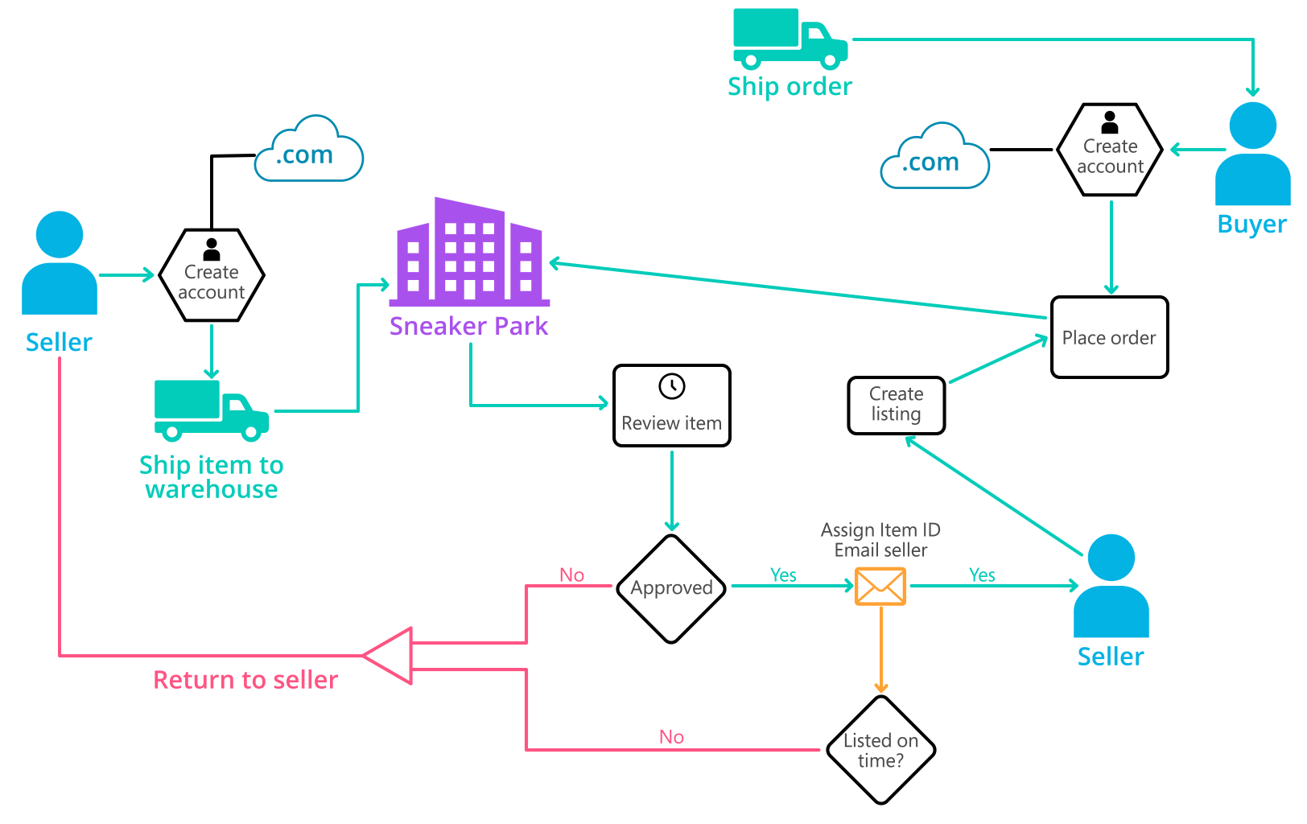
Background (cont’d)
The below diagram that will hopefully help to visualize some of SneakerPark's business processes. Howevers, it does not capture ALL processes and every nuance, but simply serves as another artifact.

Slide 4
Step 1
Enterprise Data Catalog Part 1: Enterprise Data Model

Slide 5
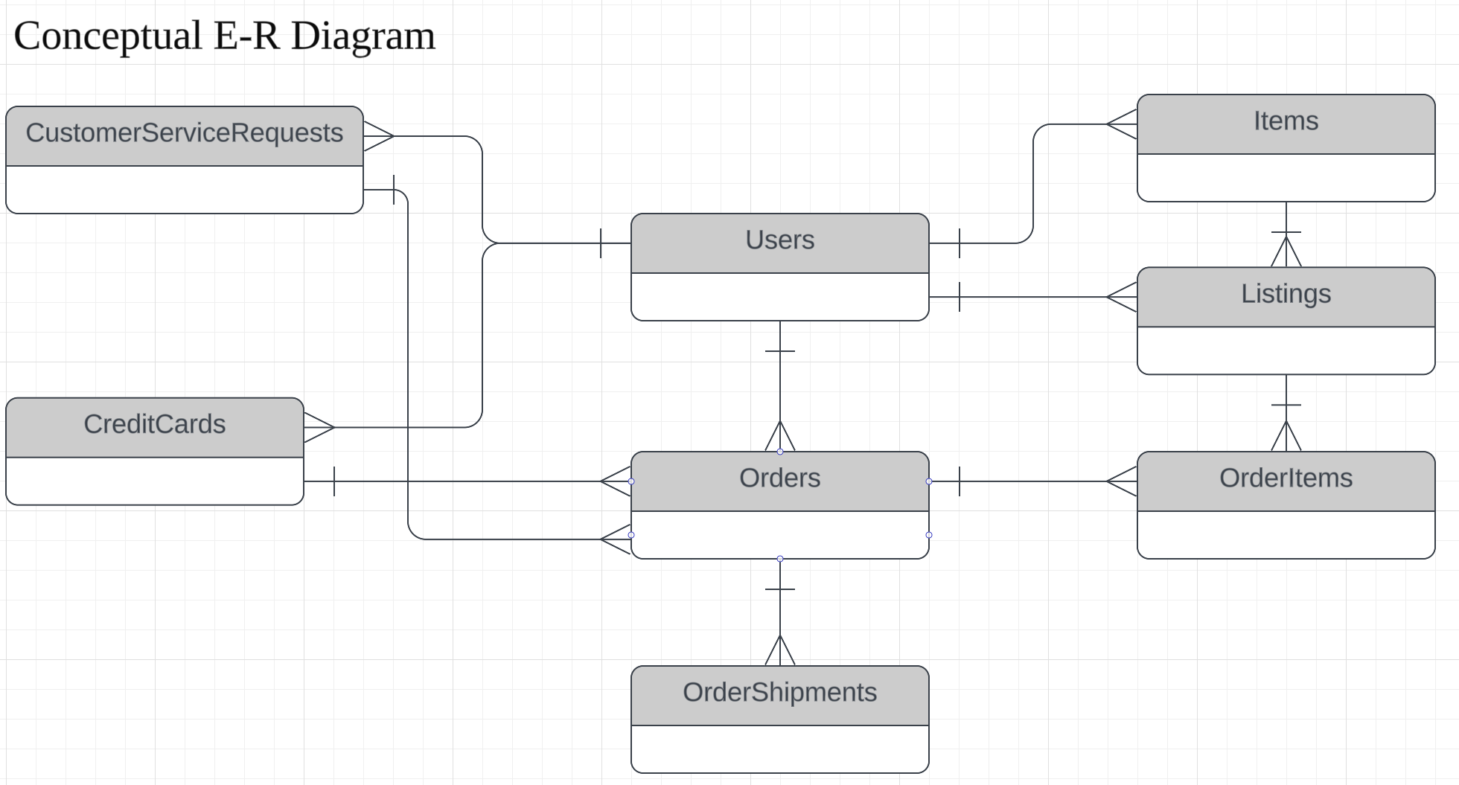
Enterprise Data Model of SneakerPark that provide the holistic view of its data systems and help grasp the organization's important entities and relationships.

Slide 6
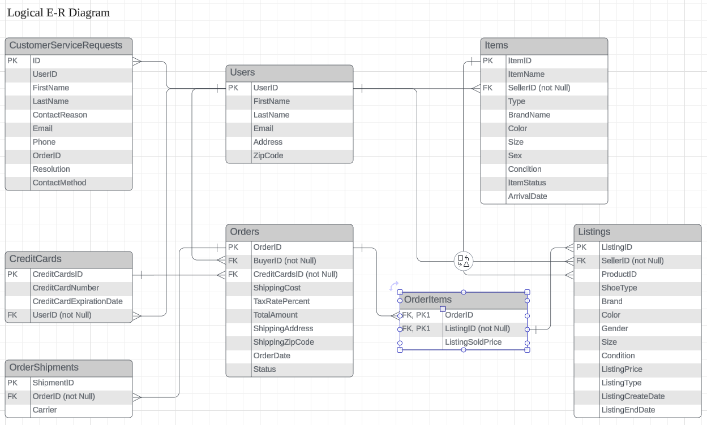

Slide 7
Step 2
Enterprise Data Catalog Part 2: Metadata

Slide 8
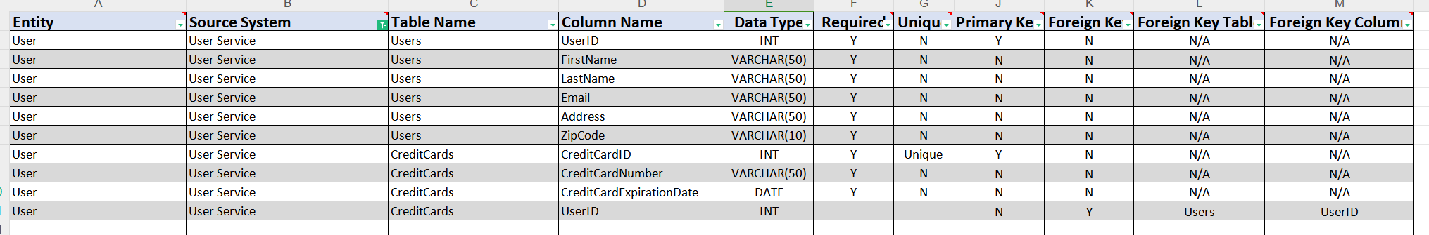
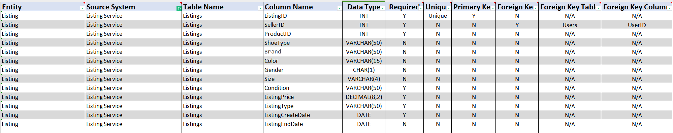
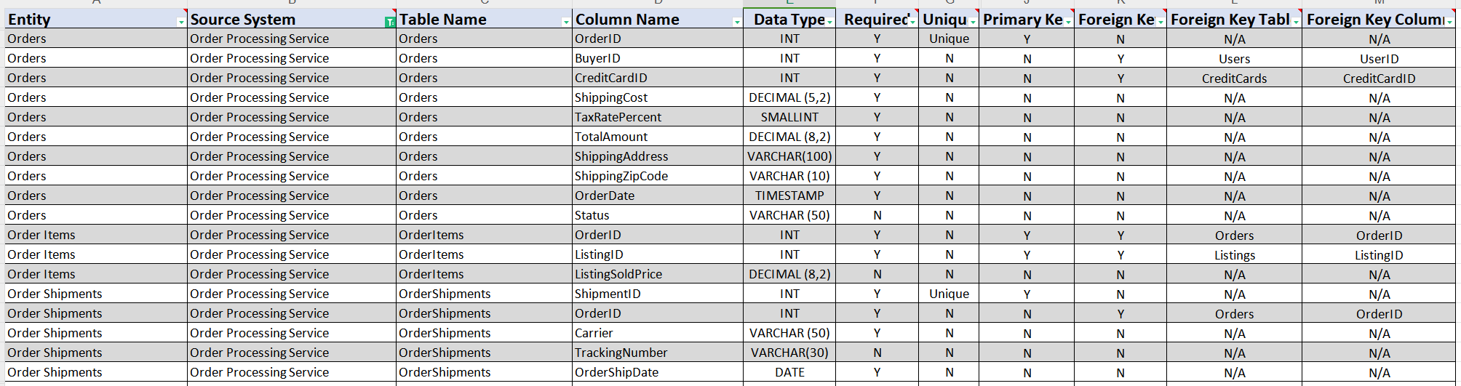
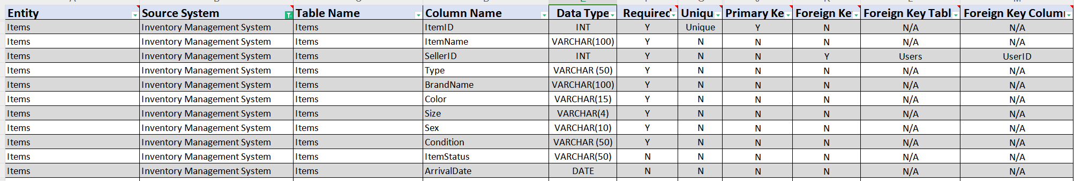
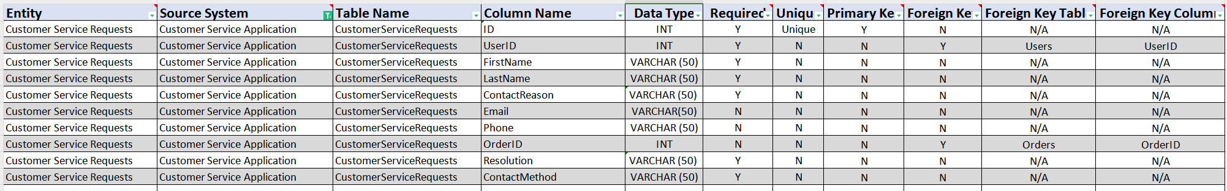
The first version of the Metadata Catalog by documenting the metadata from all systems in the "Data Dictionary" and the “Enterprise Data Catalog
Data Dictionary: Please refer to ‘EnterpriseDataCatalog.xlsx’ File

Slide 9
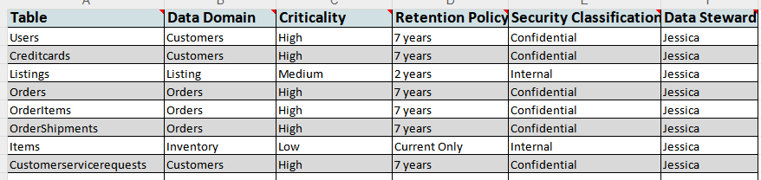
Business Metadata:

Slide 10
Step 3
Data Quality
Part 1: Profiling and Cleansing

Slide 11
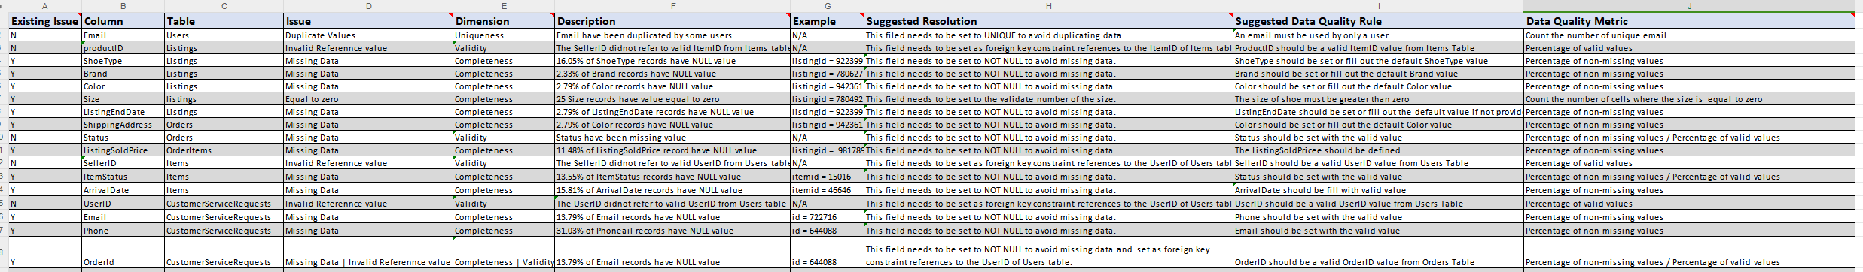
Profile the data to identify at least 3 data quality issues that found in the data. Also provide at least 1 data quality issue that haven’t yet seen in the data, but can foresee occurring in the future.
Please refer to ‘EnterpriseDataCatalog.xlsx’ File

Slide 12
Step 4
Data Quality
Part 2: Monitoring

Slide 13
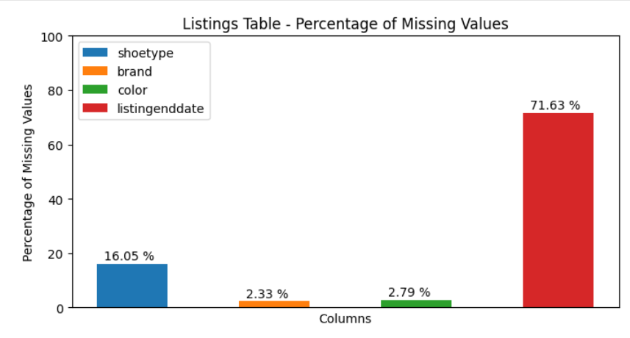
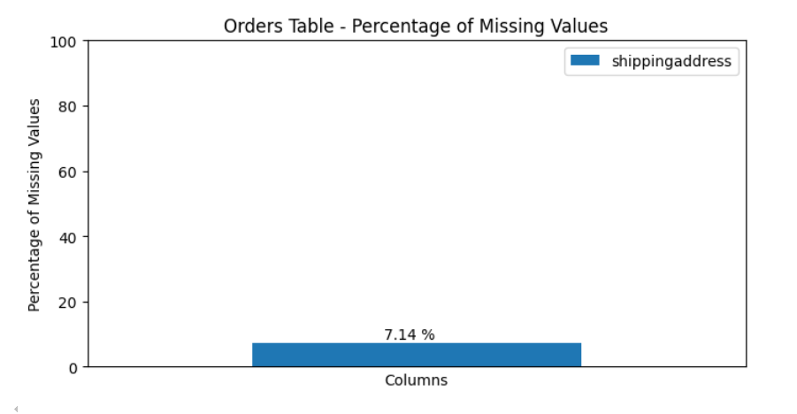
The Jupyter notebook together with some library such as numpy, matplotlib.pyplot, pandas that used to explore and draw the data quality monitoring dashboard that will be used to monitor the data to ensure compliance with data quality rules.

Slide 14
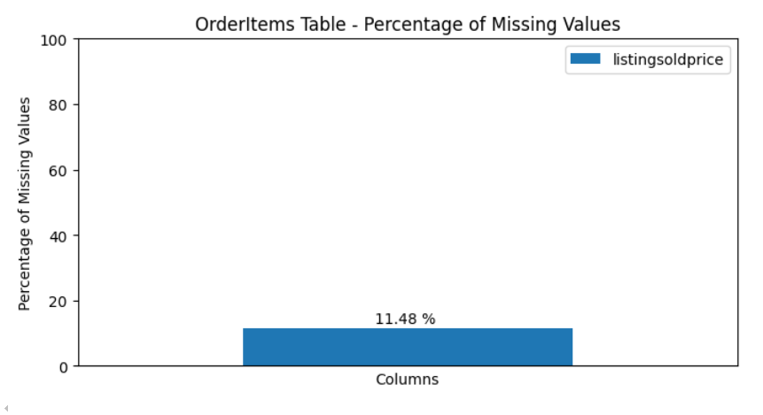
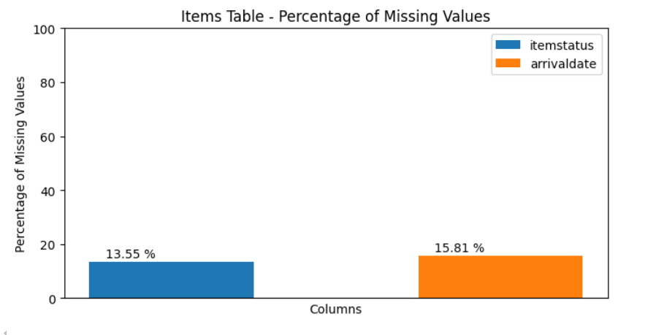
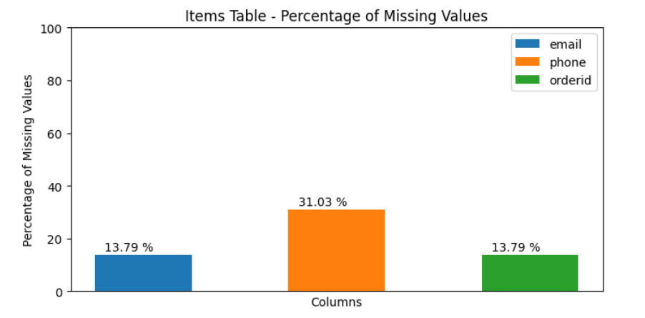

Slide 15
Step 5
Master Data Management
Part 1: MDM Architecture

Slide 16
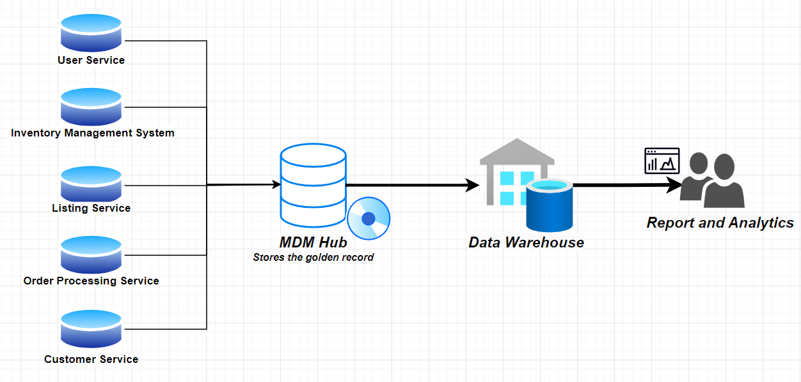
Based on what you’ve studied about SneakerPark’s systems and business model, We decided to have the proposed the architecture implementation with the Consolidated MDM style. The SneakerPark’s data were comming from vary of sources includes: User Service, Inventory Management System, Listing Service, Order Processing Service , Customer Service Application that will lead to data quality issues that currently presented and could be occurring in the future if not be improved. So that centrilzed the data from all of systems into a single place throught a MDM Hub and the Consolidate output could be a Data Warehouse that provide the golden records for others businesses requirement.
Consolidated MDM

Slide 17
Step 6
Master Data Management
Part 2: Master Record

Slide 18
Define a set of matching rules that will be used by the SneakerPark's MDM Hub to match item and customer entities between the company's different systems.
4 rules - 2 for Items and 2 for Customers
Items:
1. “Same ItemID (ProductID) and SellerID” Rule. Match the Item records on :
- ItemID of the Items table.
- SellerID of the Listings table.
2. “Sam ShoeType, BrandName, Color, Size, Condition” Rule. Match the Item records on:
- ShoeType, BrandName, Color, Size of the Items table.
- Condition of the Listings table
Customers:
1. “Same UserID ” Rule. Match the Customer records on :
- UserID of the Users table.
2. “Same FirstName, LastName, Email” Rule. Match the Customer records on :
- FirstName, LastName, Email of the Users table.

Slide 19
Step 7
Data Governance:
Roles and Responsibilities

Slide 20
The responsibilities in the context of at 3 different aspects of Data Governance such as:
- Data Quality Management
- Metadata Management
- MDM.
Do SneakerPark's current employees have the necessary skills for these roles or should the company make new hires?
Data Steward is who take ownership of the data and work with the business to define the objectives. This role have the responsbilities to maintaining the quality of data and master data management initiatives. So that Jessica could be take this role base on her business understanding through the organization.
Beside that the new hire could be consider to share workload with Jessica to work as Data engineer that work as part of an analytics team to provide data in usable formats for predictive analytics, machine learning and data mining applications.
Jake was background is in IT suppoer will be responsible for providing IT production supports. He should be trained to adopting devOps strategies by using some tools and ways of working from the devOps world to implement the automation jobs that help to reduces errors, accelerates workflows, and ensures consistent data quality.

Slide 21
Standout Suggestions

